Slide 1


Human Computer Interaction - Assignment 1
2351279 尹诚成
2351716 吴瑞翔
School of Computer Science
2025.3.22

Slide 2
Enhancing Spreadsheet Interaction on Interactive Surfaces through Pen-Based Precision Techniques
2351279 尹诚成
2351716 吴瑞翔
School of Computer Science
2025.3.22

Slide 3
1 Introduction
Introduction
Related Work
Methodology
Experimental Results
Summary and Future Directions
Reflections
1
2
3
Catalogue
4
5
6

Slide 4
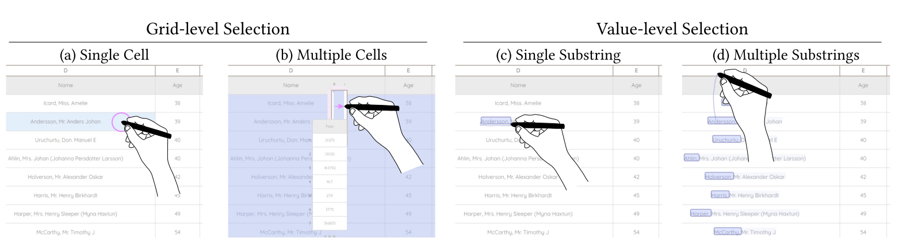
1 Introduction
Significance
Background: Spreadsheets are essential but face input conflicts on interactive surfaces.
Challenges: Grid layers intercept touch events, leading to cumbersome operations.
Goal: Propose pen-based techniques to resolve conflicts and improve efficiency.

Slide 5
2 Related Work
Introduction
Related Work
Methodology
Experimental Results
Summary and Future Directions
Reflections
1
2
3
Catalogue
4
5
6

Slide 6
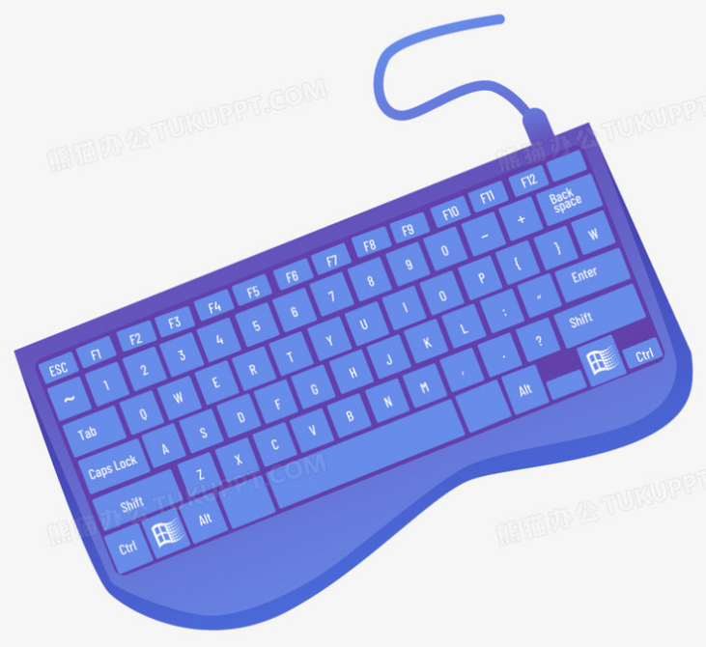
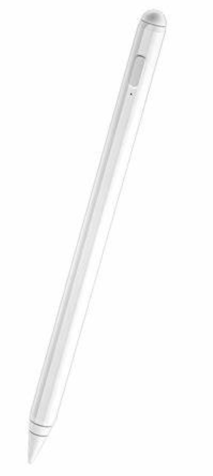


2 Related Work
Current Research and Challenges
Spreadsheet Interaction
Current Research: Data visualization, sorting, filtering, keyboard-mouse dependency, pen-based sketch interaction, multimodal interaction (TouchPivot).
Challenges: Insufficient cross-layer interaction, inter-layer input conflicts, desktop logic redundancy.
Pen+Touch Interaction Techniques
Current Research: Task division (pen for precise input, touch for coarse-grained operations), note-taking, document editing, interface control, data visualization.
Challenges: Integration of additional modalities, complexity, user learning costs.

Slide 7
3 Methodology
Introduction
Related Work
Methodology
Experimental Results
Summary and Future Directions
Reflections
1
2
3
Catalogue
4
5
6

Slide 8
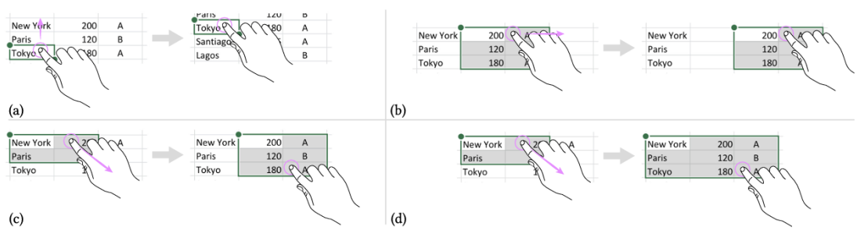
3 Methodology
(1) Commercial Software Analysis
Analysis Scope: Microsoft Excel, Apple Numbers, Google Sheets across Windows, iPadOS, and macOS.
Hardware Coverage: Tablets, touchscreens, and digital tablets.
Key Findings:
Inconsistent input-event mappings.
Grid-layer interception causing layer conflicts.
Fragmented logic in modality division.

Slide 9
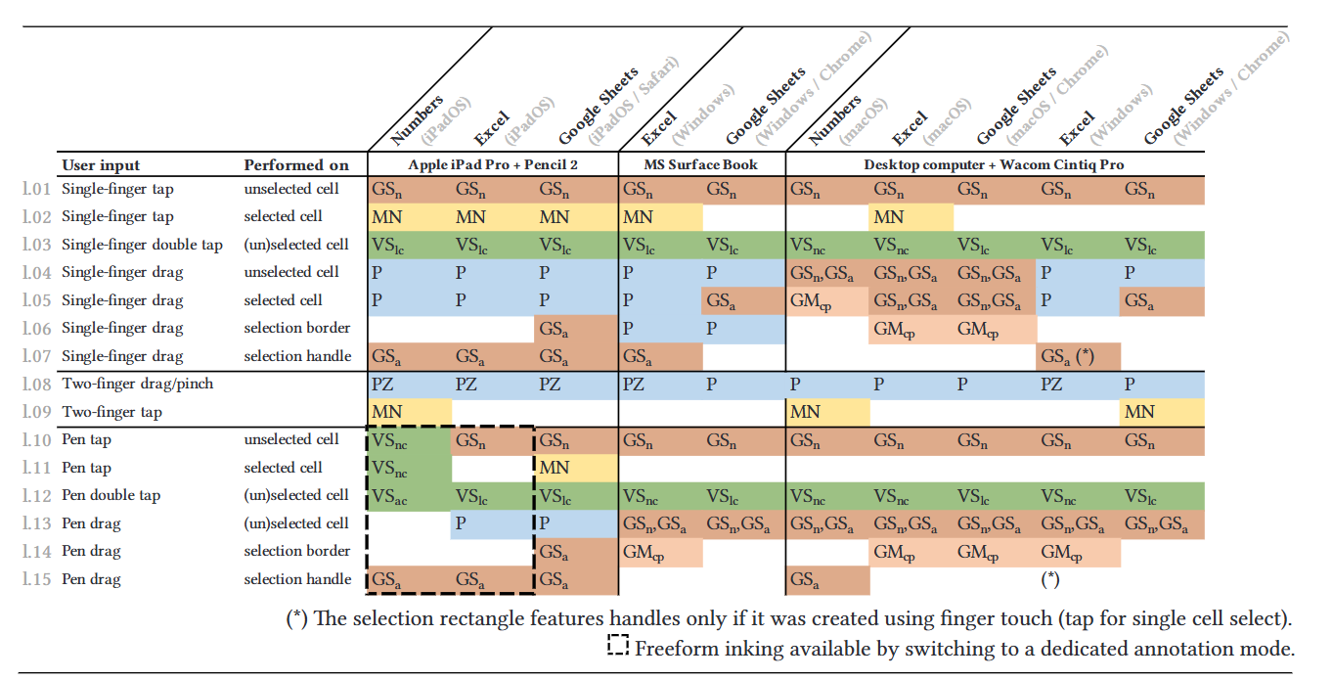
3 Methodology
(1) Commercial Software Analysis

Slide 10
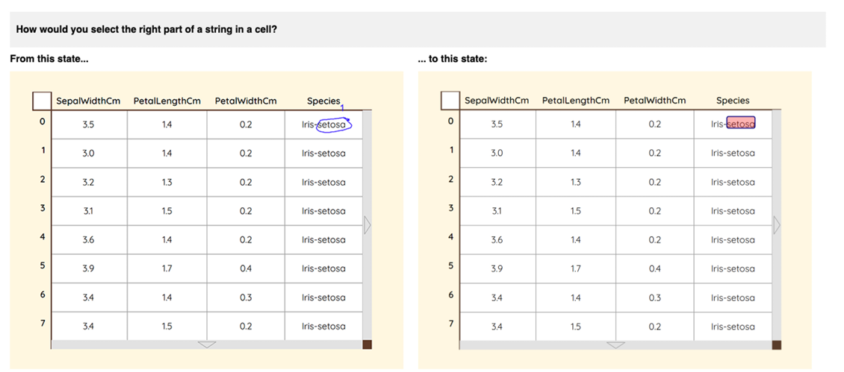
3 Methodology
(2) User Needs Survey
Participants: 16 users with varying spreadsheet experience.
Survey Focus: Gesture proposals for 28 operations.
Key Insights: Modality Ambiguity, Natural Gesture Preferences, Underutilized Multimodality, Frequent Mode-Switching

Slide 11
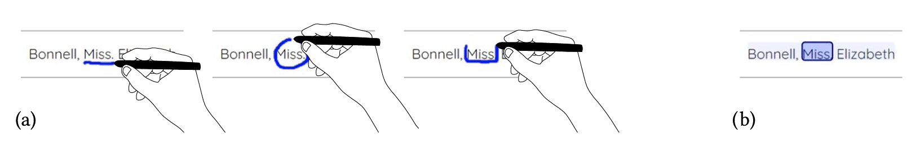
3 Methodology
(3) Interaction Design
Pen Precision Operations: Cell selection, freeform ink strokes, semantic extensions.
Touch Layout Operations: Single-finger dragging, two-finger pinch gestures, eraser-end operations.

Slide 12
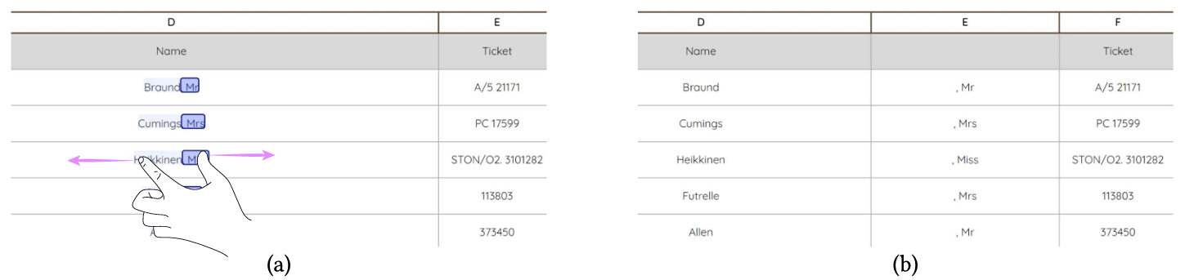
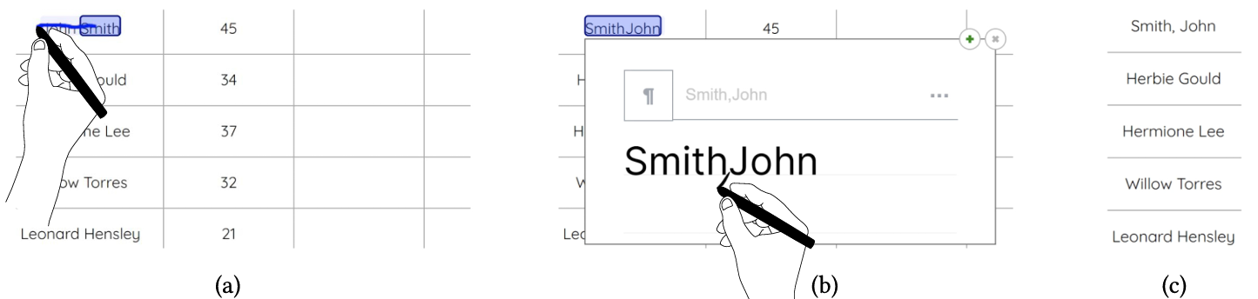
3 Methodology
(3) Interaction Design
Cross-Layer Operations: Substring generalization algorithm for pattern generalization.

Slide 13
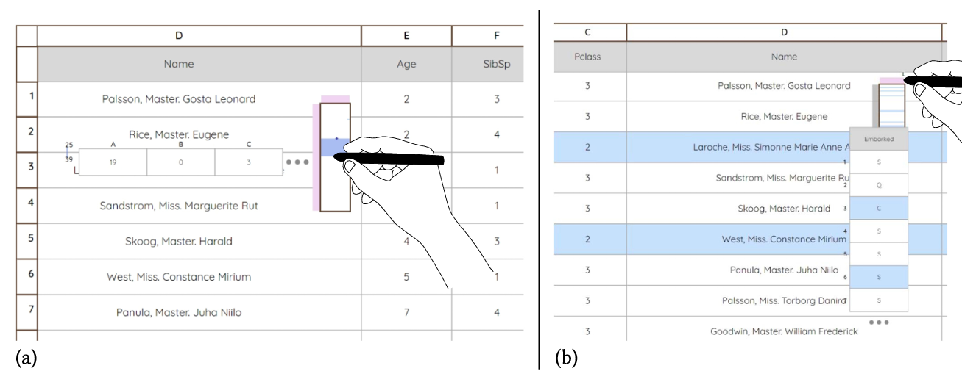
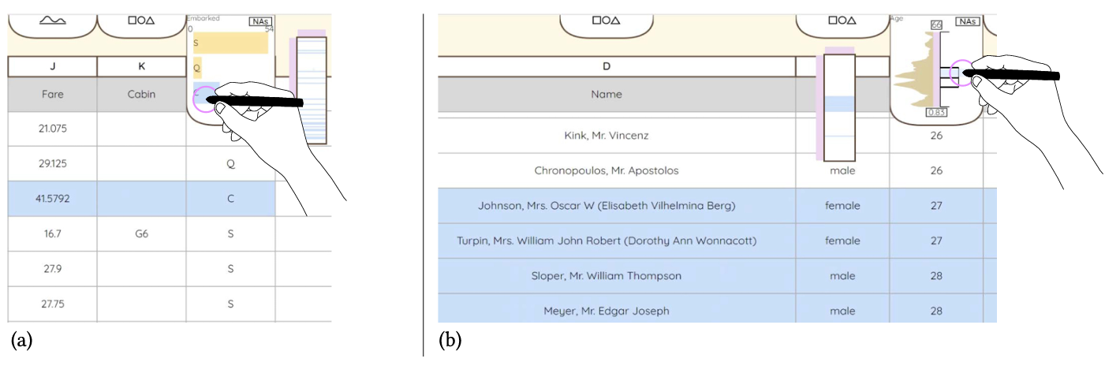
3 Methodology
(3) Interaction Design
Navigation Optimization: Minitable and Minivis tools enhance data exploration and filtering.

Slide 14
4 Experimental Results
Introduction
Related Work
Methodology
Experimental Results
Summary and Future Directions
Reflections
1
2
3
Catalogue
4
5
6

Slide 15
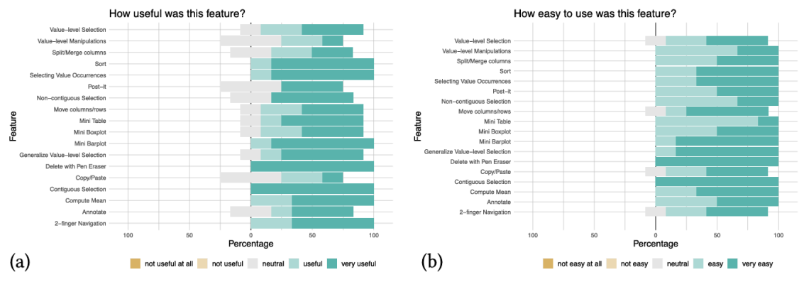
4 Experimental Results
Enhancing User Efficiency & Interaction Fluidity

Slide 16
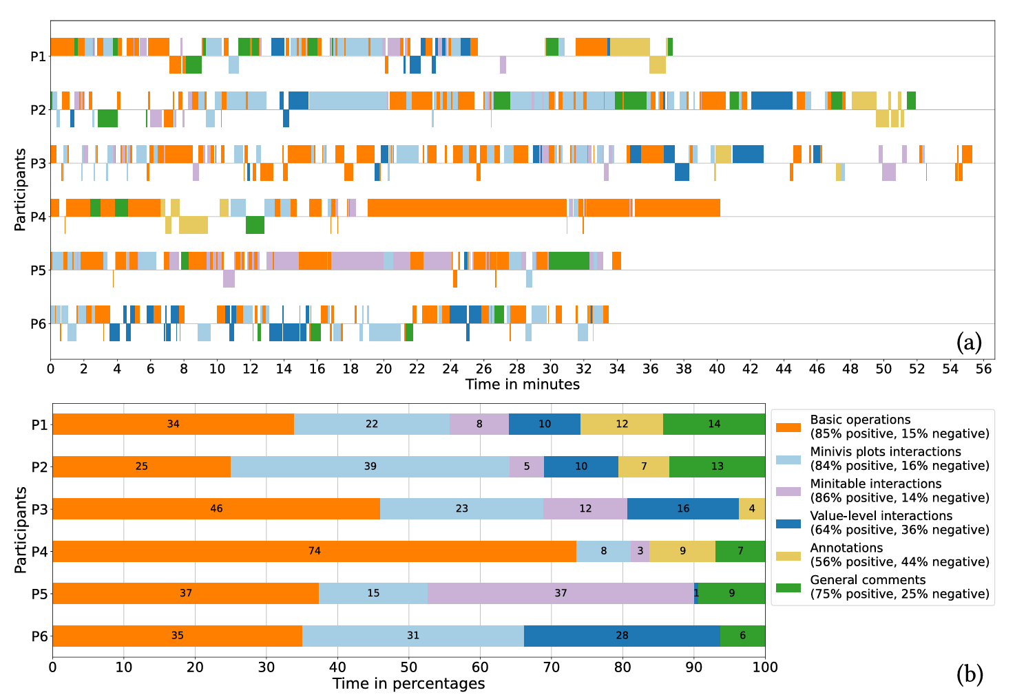
4 Experimental Results
Enhancing User Efficiency & Interaction Fluidity

Slide 17
5 Summary and Future Directions & 6 Reflections
Introduction
Related Work
Methodology
Experimental Results
Summary and Future Directions
Reflections
1
2
3
Catalogue
4
5
6

Slide 18
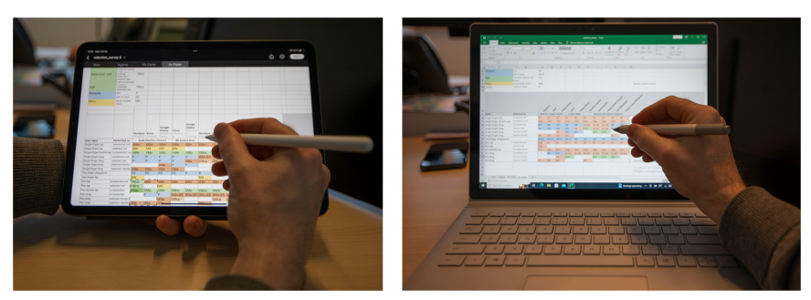
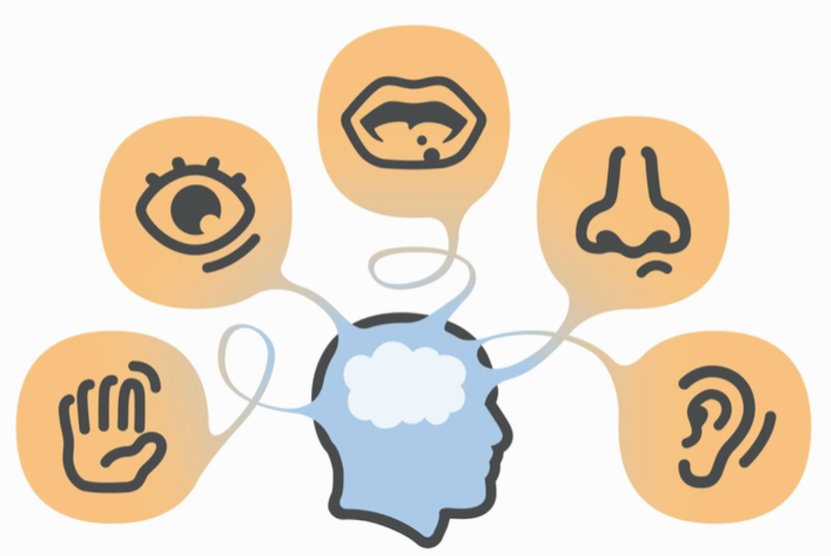
5 Summary and Future Directions & 6 Reflections
Multimodal Interaction
Summary: Pen-touch collaboration
resolves hierarchical conflicts and enhances data manipulation.
Future Directions: Expand direct manipulation paradigm, develop novel interaction grammars, and balance innovation with user inertia.
Key Insights: Pen-based precision interaction resolves input conflicts and offers intuitive workflows.
Future Potential: Multimodal interaction can be further enhanced with hardware advancements and user-centric design.

Slide 19
Reference
Cavez, Vincent, et al. “Spreadsheets on interactive surfaces: Breaking through the grid with the pen.” ACM Transactions on Computer-Human Interaction, vol. 31, no. 2, 29 Jan. 2024, pp. 1–33, https://doi.org/10.1145/3630097.

Slide 20
Research on the Development Status of Multimodal Non-Invasive Brain-Computer Interfaces
2351279 尹诚成
2351716 吴瑞翔
School of Computer Science
2025.3.22

Slide 21
1 Introduction
1
Introduction
Development Status of Multimodal Non-Invasive BCIs
Recommendations for the Development of Multimodal Non-Invasive BCIs
Reflections, Summary and Outlook
2
Catalogue
3
4

Slide 22
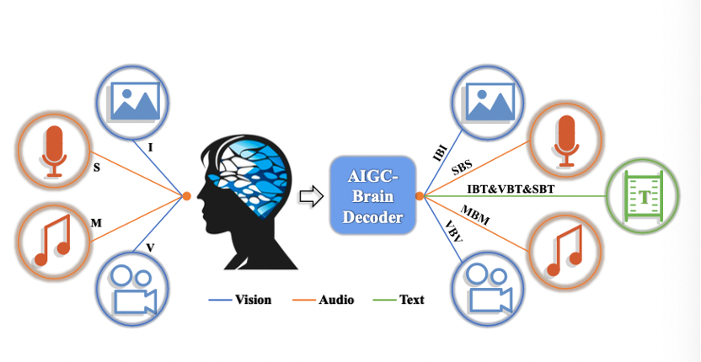
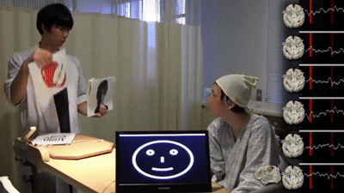
1 Introduction
Research Significance
Technological development: Grasping trends and driving innovation
Market demand: Meeting consumer needs and promoting industrial upgrading
Policy formulation: Establishing reasonable standards to guide healthy industry development

Slide 23
2 Development Status of Multimodal Non-Invasive BCIs
1
Introduction
Development Status of Multimodal Non-Invasive BCIs
Recommendations for the Development of Multimodal Non-Invasive BCIs
Reflections, Summary and Outlook
2
Catalogue
3
4

Slide 24
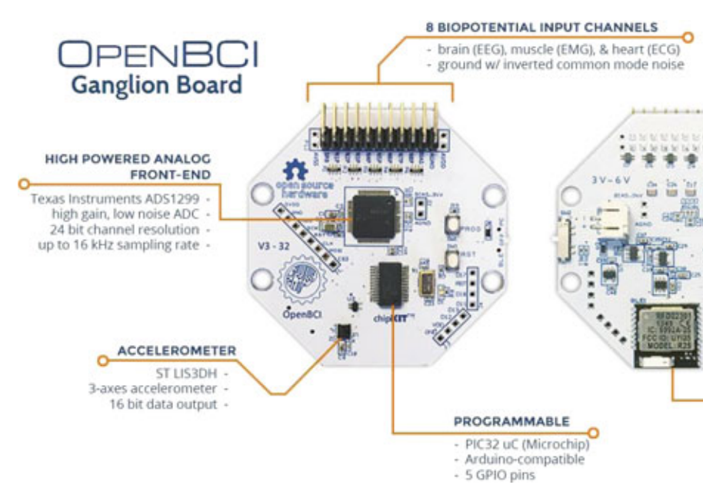
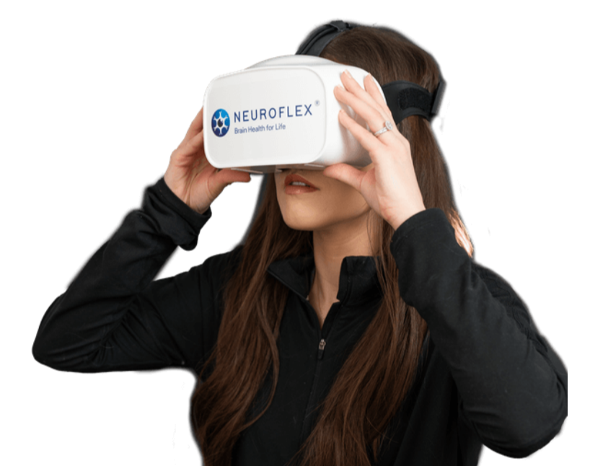
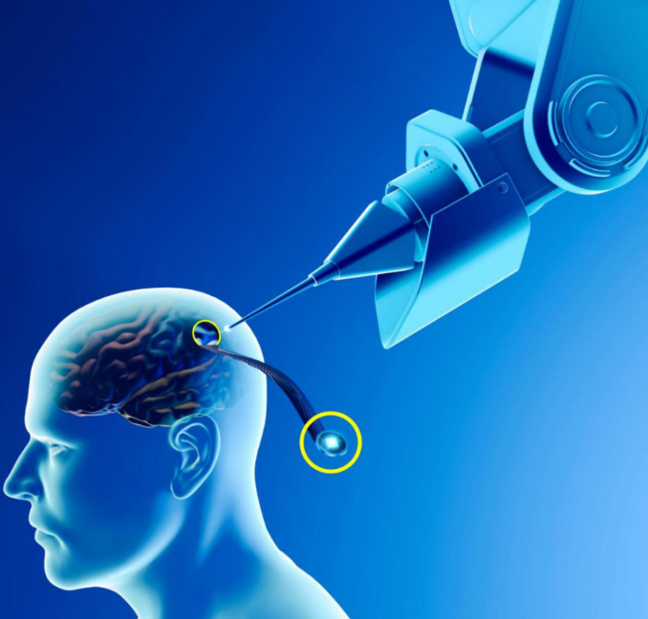
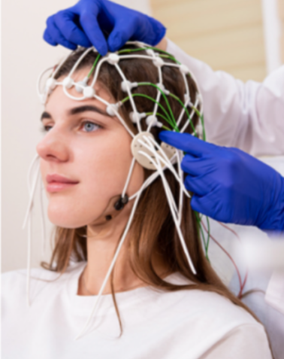
2 Development Status of Multimodal Non-Invasive BCIs
(1) Signal Acquisition and Preprocessing Techniques
Device Progress:
Wireless multi-channel devices enable real-time signal acquisition.
Seamless integration with multimodal modules.
Flexible Electronics:
Graphene-based flexible electrodes conform to the scalp, optimizing wearability.
Invasive vs. Non-Invasive:
Invasive technologies offer high precision but are limited by surgical implantation, hindering clinical adoption.
V.S

Slide 25
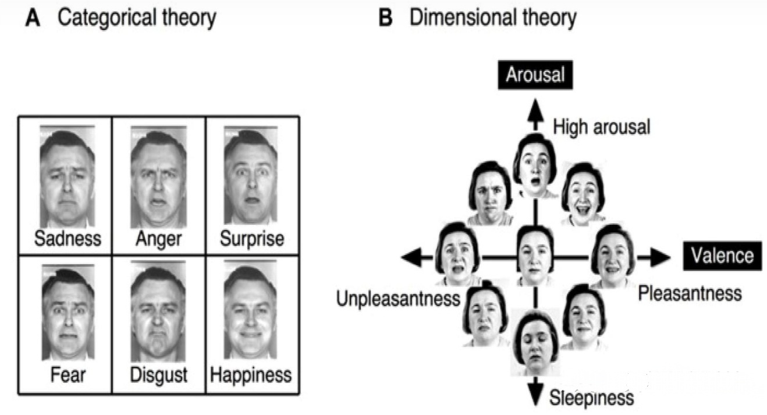
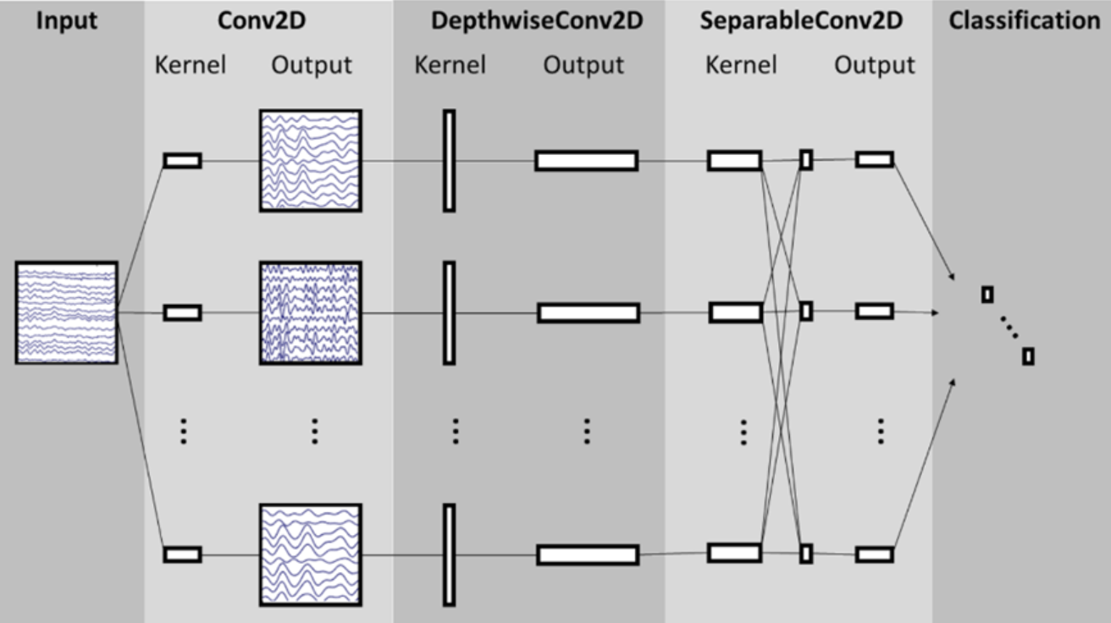
2 Development Status of Multimodal Non-Invasive BCIs
(2) Decoding Algorithms and Classification Models
Deep Learning Methods:
Lightweight convolutional networks show significant potential in multimodal signal analysis.
Applied to tasks like emotion recognition, but high computational demands limit real-time performance on edge devices.
Challenges:
Complexity of multimodal signals.
Performance limitations of edge devices.

Slide 26
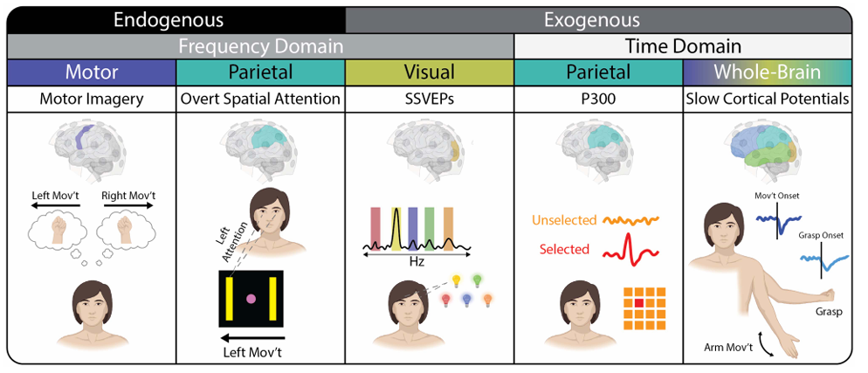
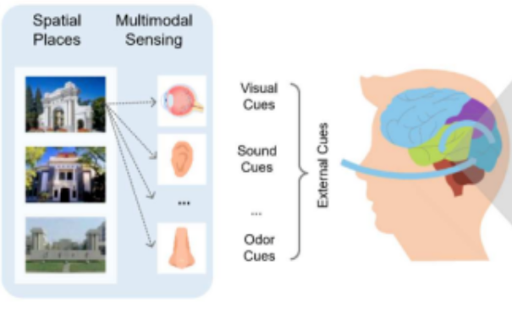
2 Development Status of Multimodal Non-Invasive BCIs
(3) Multimodal Feedback Mechanisms
Visual Feedback: Real-time robotic posture mapping enhances user perception and confidence.
Tactile and Auditory Feedback:
Tactile vibration feedback encodes operational states.
Auditory cues assist in rapid system response recognition.

Slide 27
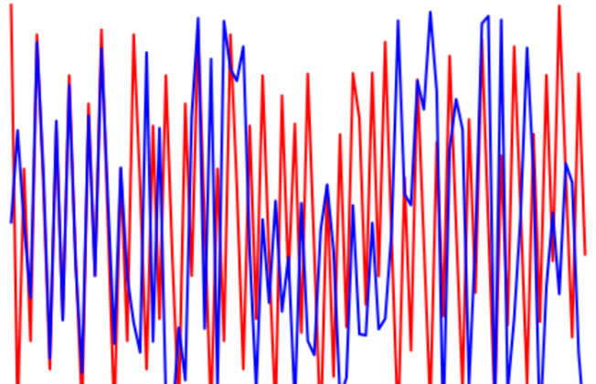
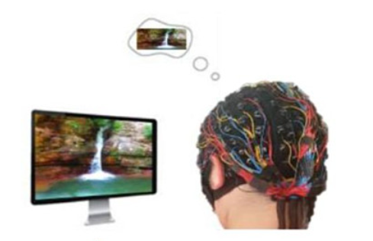
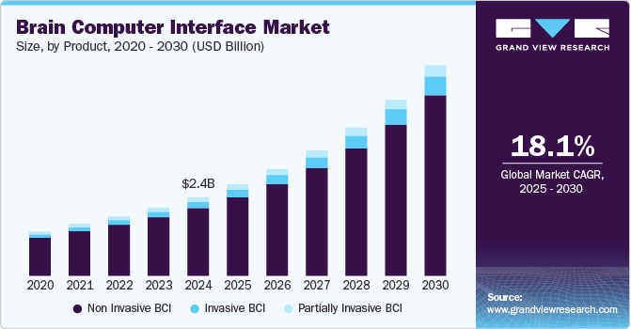
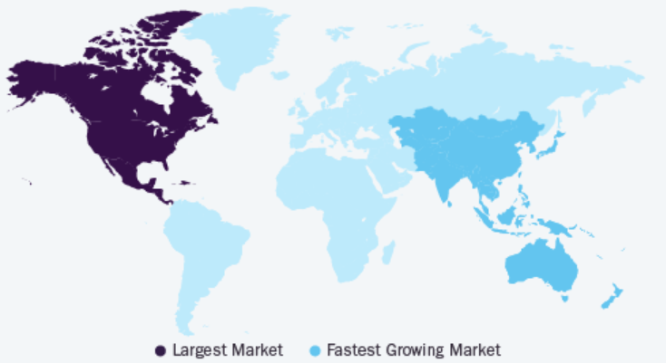
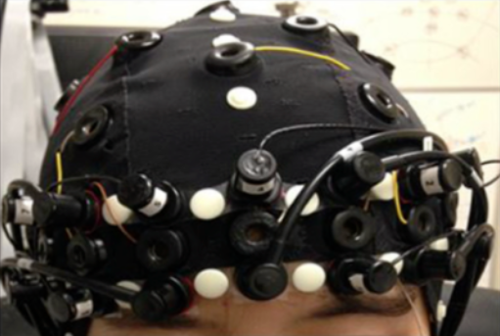
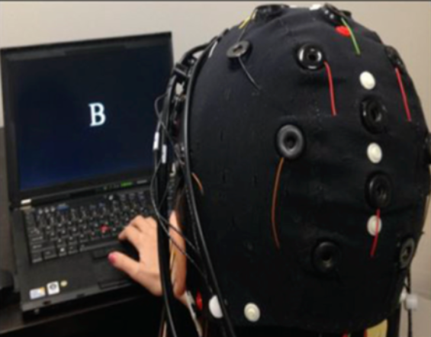
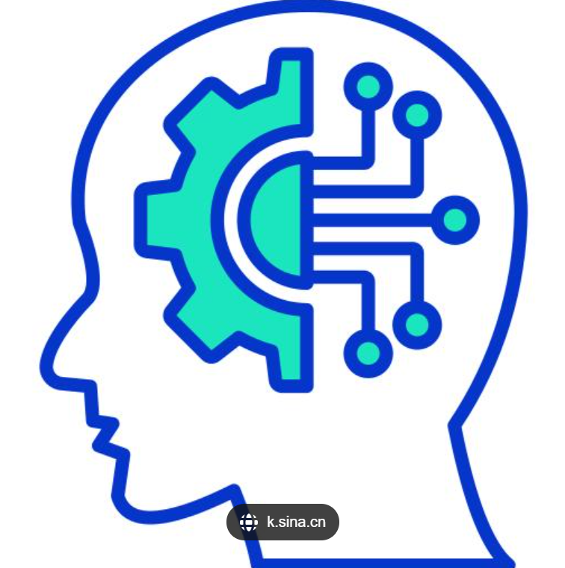
2 Development Status of Multimodal Non-Invasive BCIs
(4) Technical Bottlenecks and Challenges & (5) Market Size
Real-Time Performance
Signal Reliability
BOTTLENECKS
& CHALLENGES
Multimodal Signal Synchronization
Privacy and Security

Slide 28
3 Recommendations for the Development of Multimodal Non-Invasive BCIs
1
Introduction
Development Status of Multimodal Non-Invasive BCIs
Recommendations for the Development of Multimodal Non-Invasive BCIs
Reflections, Summary and Outlook
2
Catalogue
3
4

Slide 29
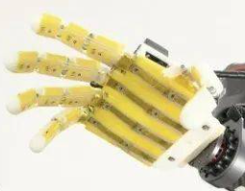
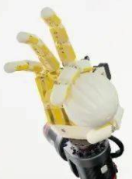
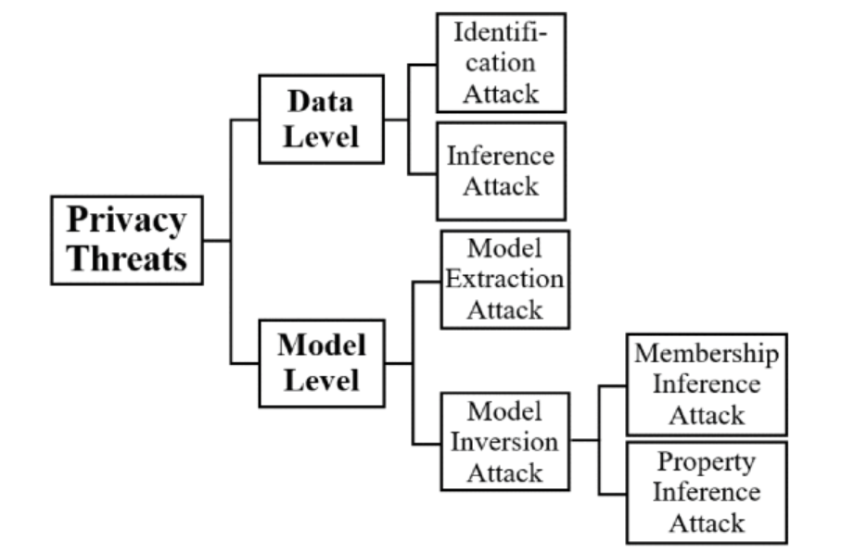
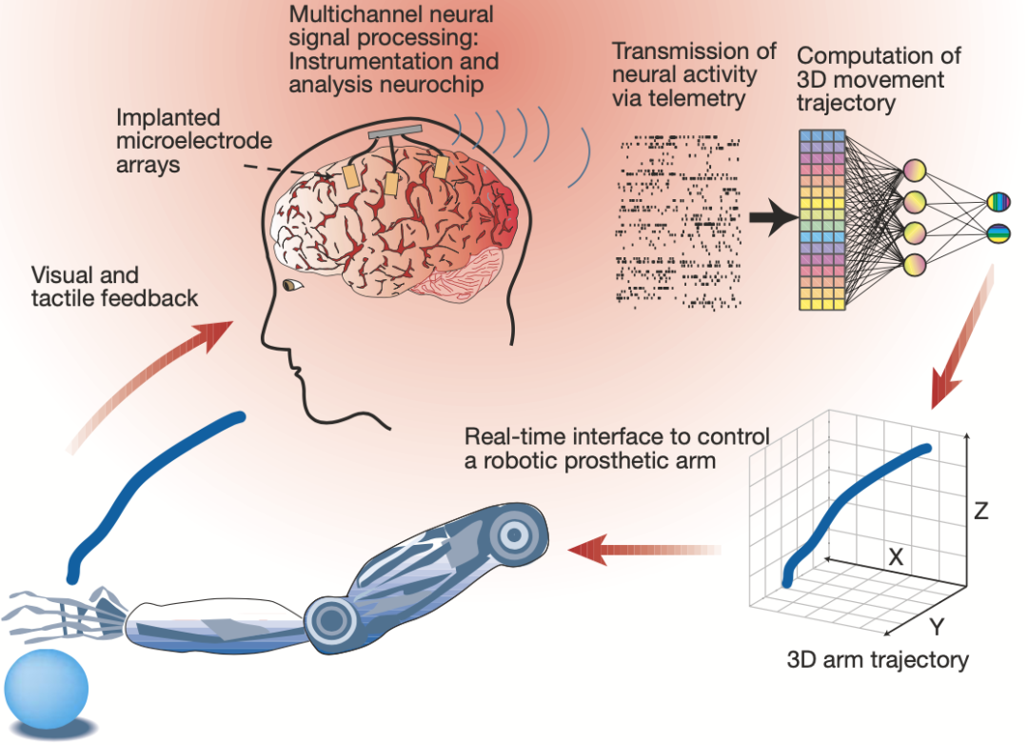
3 Recommendations for the Development of Multimodal Non-Invasive BCIs
Future Development Recommendations
Technological Innovation and Hardware Optimization
Optimizing User Experience
Privacy Protection and Data Security

Slide 30
4 Reflections, Summary and Outlook
1
Introduction
Development Status of Multimodal Non-Invasive BCIs
Recommendations for the Development of Multimodal Non-Invasive BCIs
Reflections, Summary and Outlook
2
Catalogue
3
4

Slide 31
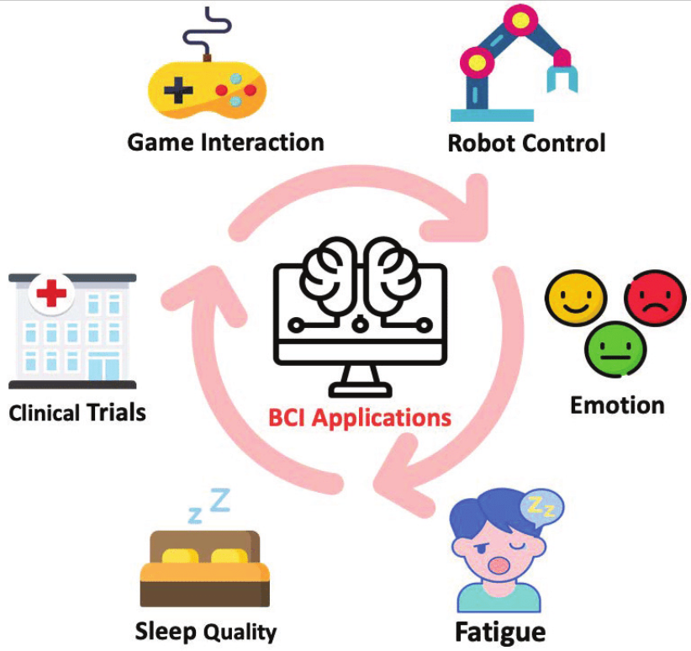
4 Reflections, Summary and Outlook
Conclusion and Prospects
Future Directions:
Lightweight design and hardware acceleration.
Low-cost software solutions.
Privacy protection technologies.
Current Status: Hardware and algorithm co-optimization, significant potential of multimodal feedback mechanisms.
Vision: Promote the transition of BCIs from laboratories to daily life, reshaping human-computer interaction paradigms.

Slide 32
References
[1] Samson, V. R., et al. “Electroencephalogram-based openbci devices for disabled people.” Lecture Notes in Electrical Engineering, 7 Sept. 2017, pp. 229–238, https://doi.org/10.1007/978-981-10-4280-5_24.
[2] Asgher, Umer, et al. “Editorial: Advances in artificial intelligence (AI) in Brain Computer Interface (BCI) and Industry 4.0 for Human Machine Interaction (HMI).” Frontiers in Human Neuroscience, vol. 17, 5 Dec. 2023, https://doi.org/10.3389/fnhum.2023.1320536.
[3] Rahman, Md. Mustafizur, et al. “Recognition of human emotions using EEG Signals: A Review.” Computers in Biology and Medicine, vol. 136, Sept. 2021, p. 104696, https://doi.org/10.1016/j.compbiomed.2021.104696.
[4] StartUs Insights. “Discover 5 Top Brain-Computer Interface (BCI) Solutions.” StartUs Insights, 8 Dec. 2021, www.startus-insights.com/innovators-guide/brain-computer-interface/.
[5] Tang, Wenzhe, et al. “Emerging themes and future directions in Neurodesign and human-computer interaction: A systematic review.” International Journal of Human–Computer Interaction, vol. 41, no. 2, 17 June 2024, pp. 1652–1673, https://doi.org/10.1080/10447318.2024.2362486.
[6] Edelman, Bradley J., et al. “Non-invasive brain-computer interfaces: State of the art and trends.” IEEE Reviews in Biomedical Engineering, vol. 18, 2025, pp. 26–49, https://doi.org/10.1109/rbme.2024.3449790.
[7] “Brain-Computer Interface Market Size, Share, Trends & Insights Report, 2035.” Brain-Computer Interface Market Size, Share, Trends & Insights Report, 2035, 27 Jan. 2025, www.rootsanalysis.com/brain-computer-interface-market.

Slide 33

Thanks For Your Attention！
Group Members: Chengcheng Yin Ruixiang Wu
Instructor：Ying Shen Date：2025/03/22

